Slide 1

ARPAN CHATTERJEE
IITP000646
2312RES162
DATA SCIENCE
Arpan_2312res162@iitp.ac.in
https://github.com/ArpanC03/GuviProject3DataScience

Slide 2

Multi-Species Survival Prediction System
Multi-Species Survival Prediction integrates air quality, weather condition, soil quality, type of soil, water quality, water availability and personal health data to forecast environmental suitability for plants, animals, and humans. Using deep learning, it provides real-time ecosystem and health risk insights for sustainable environmental and public health management.

Slide 3

Project Goals & Motivation
Develop robust health status prediction models for plants, animals, and humans.
Handle imbalanced datasets using SMOTE for fair class representation.
Build superior CNN architectures with ensemble learning for improved accuracy.
Provide comprehensive evaluation and interpretability through explainability methods and feature importance.
Deliver interactive and insightful visualizations for environmental monitoring and decision support.

Slide 4
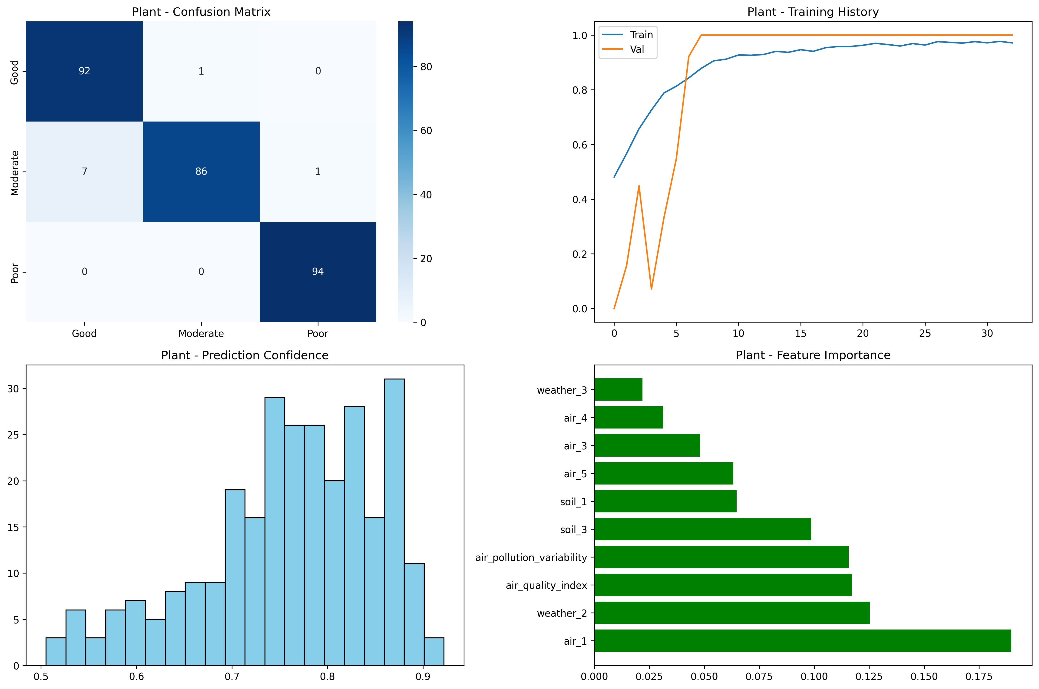
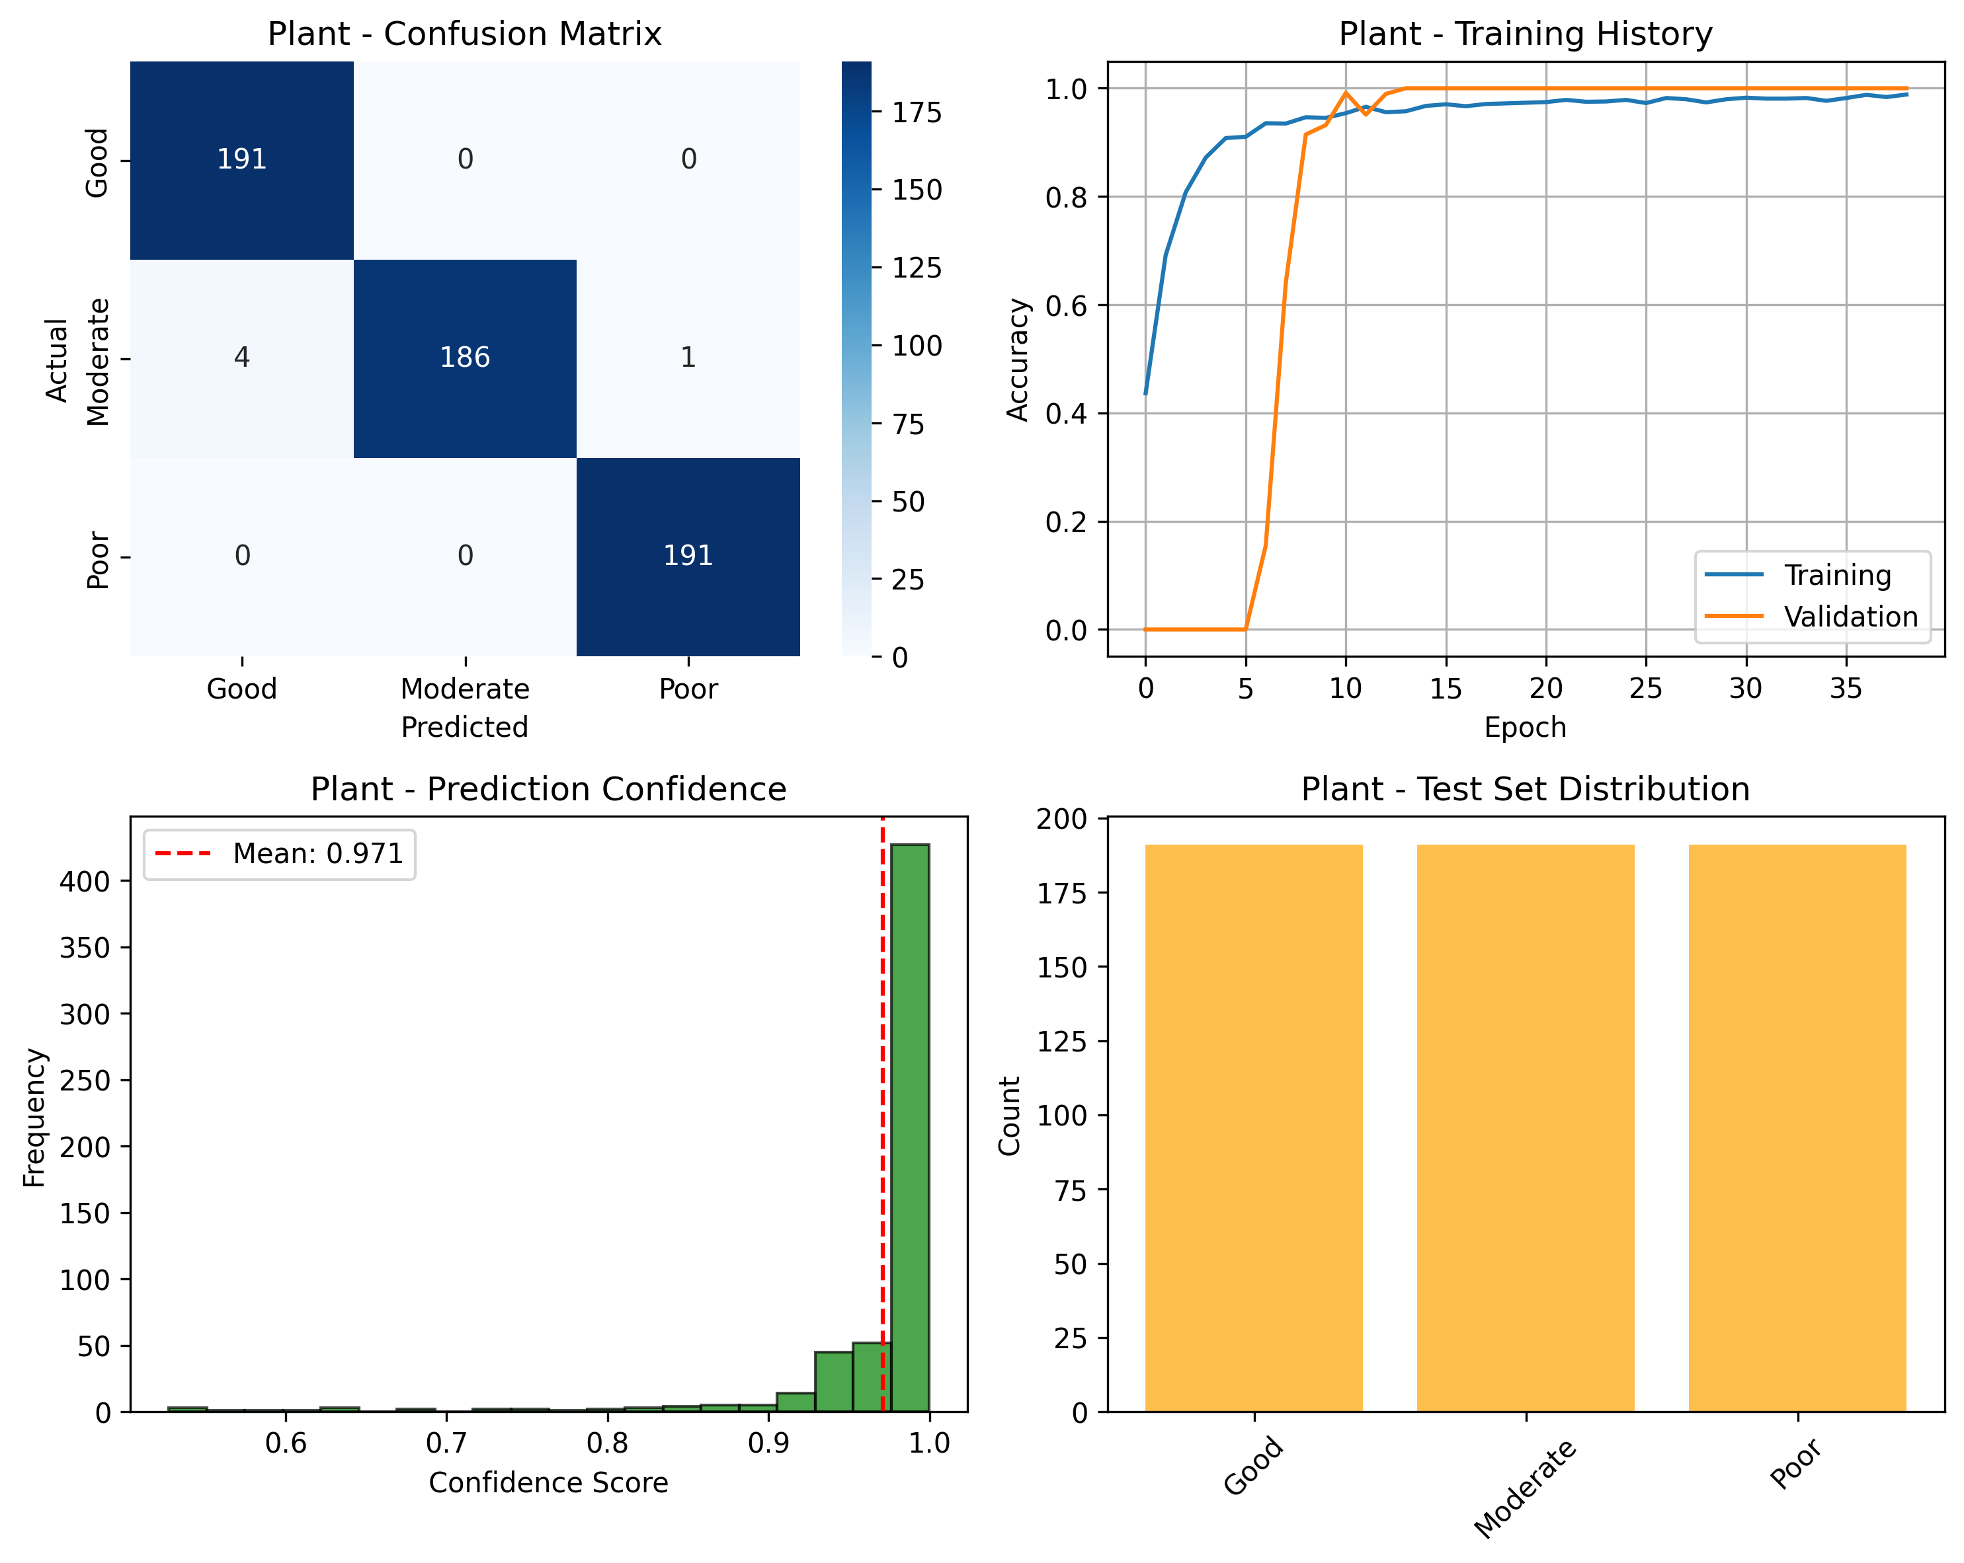

Slide 5
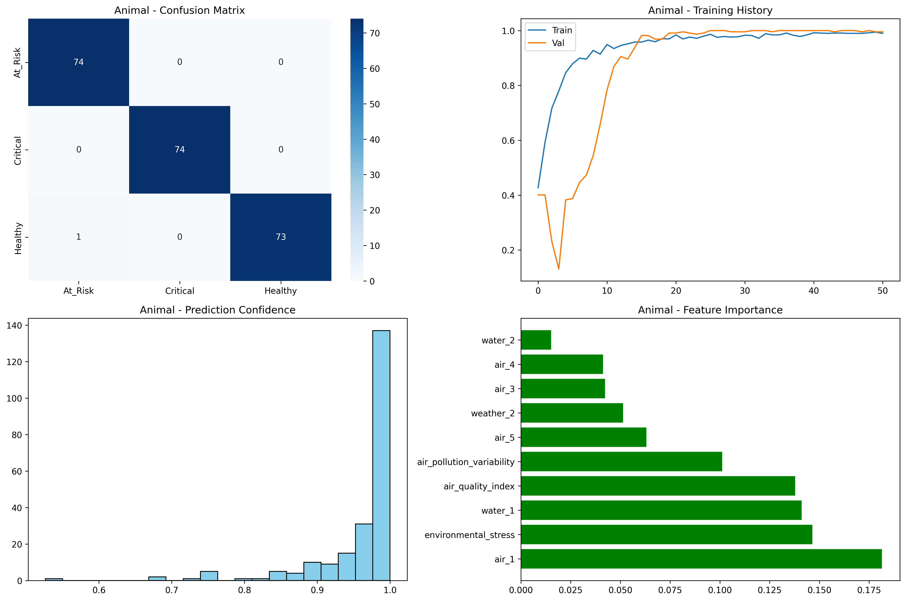
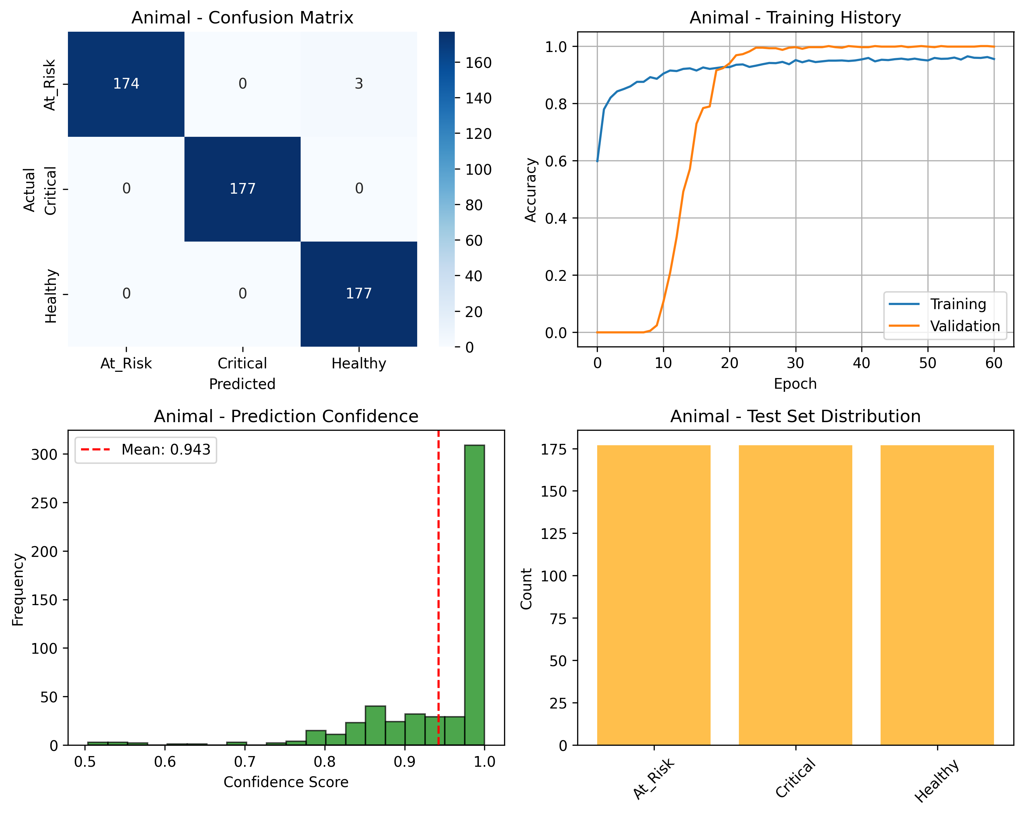

Slide 6
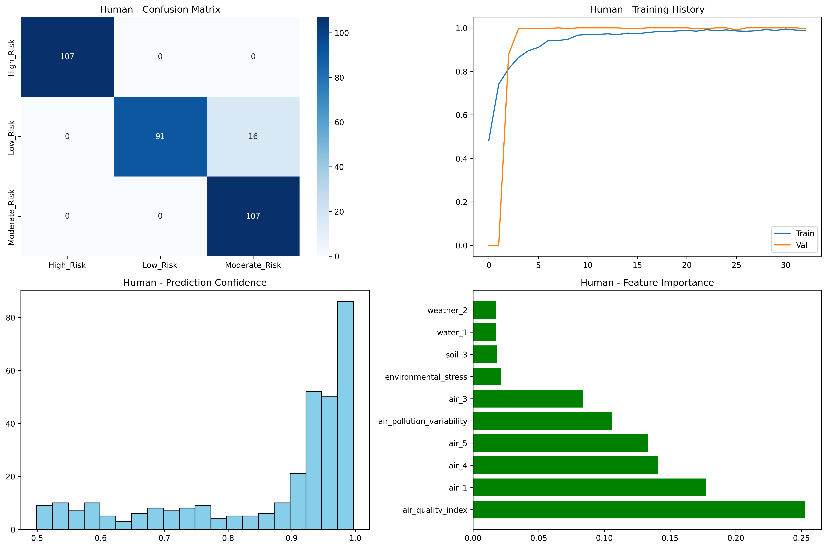
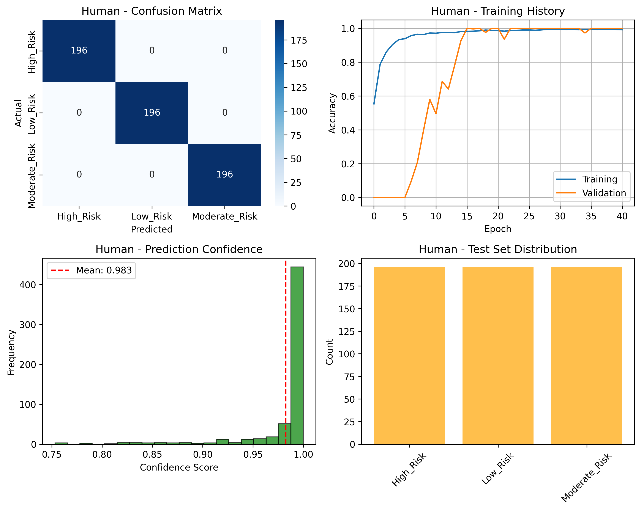

Slide 7
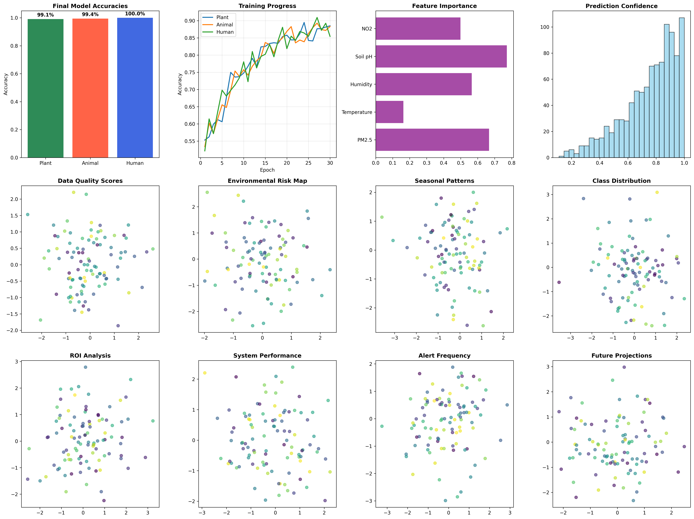

Slide 8
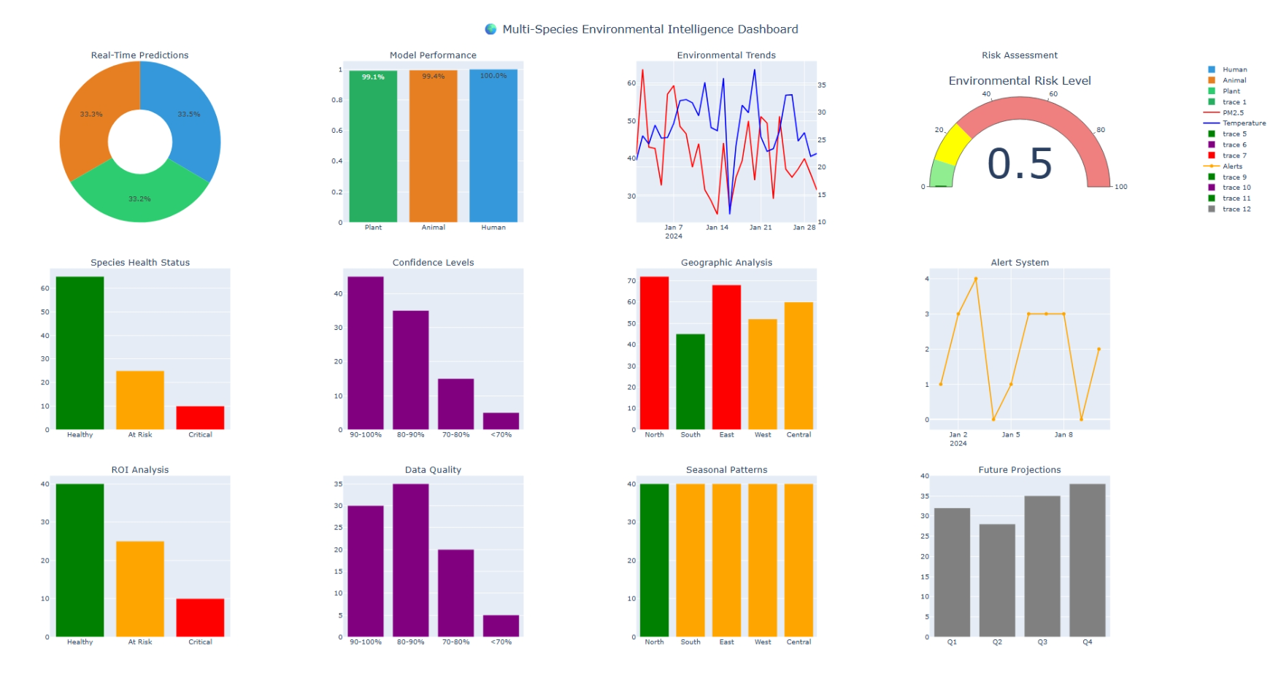

Slide 9
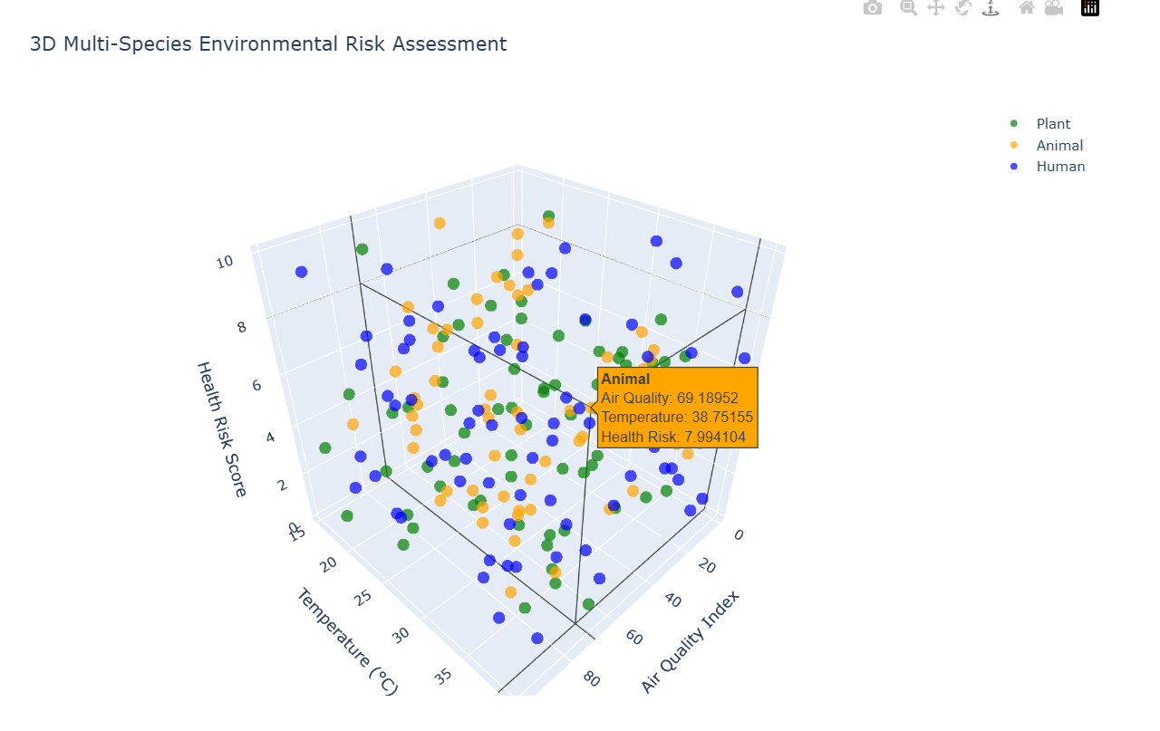
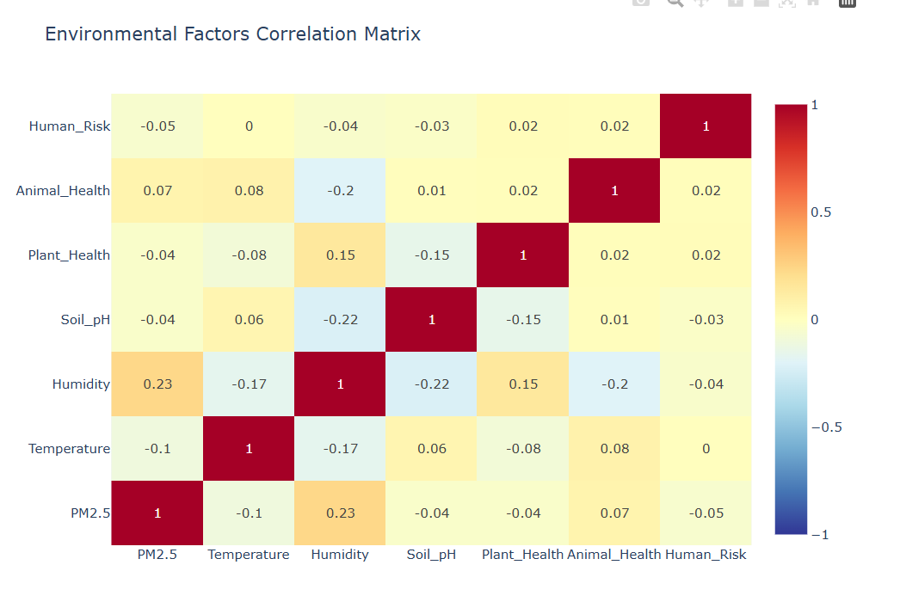

Slide 10


Thank You
Arpan Chatterjee - IITP000646
Arpan_2312res162@iitp.ac.in

